Slide 1





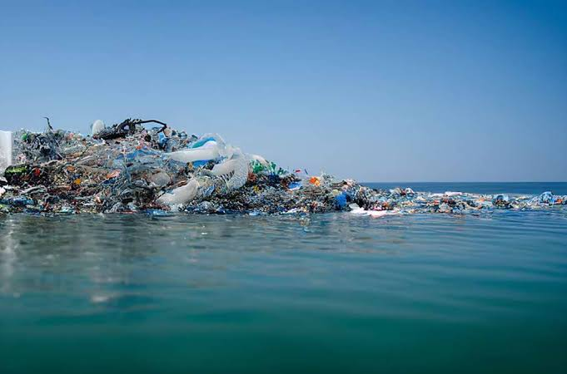
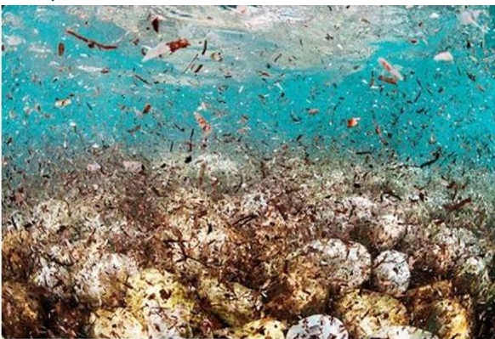
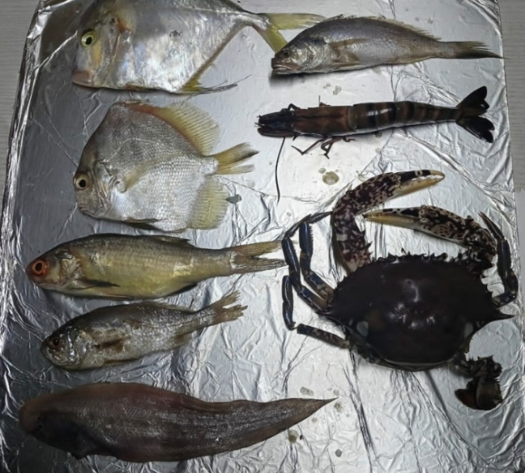
ASSESSMENT OF MICROPLASTICS POLLUTION IN COMMERCIAL FISHERIES PROCURED FROM MAJOR LANDING SITES ACROSS SIX COASTAL STATES IN NIGERIA.
^{1*}Arokoyu, D. and ^{1,2}Sogbanmu, T. O.
¹Ecotoxicology and Conservation Unit, Department of Zoology, Faculty of Science, University of Lagos, Akoka, Lagos, Nigeria
²Evidence Use in Environmental Policymaking in Nigeria (EUEPiN), University of Lagos, Akoka, Lagos, Nigeria
Correspondence* damilolarokoyu@gmail.com | tsogbanmu@unilag.edu.ng
Presented at the 18th UNILAG ANNUAL RESERARCH CONFERENCE

Slide 2
OUTLINE
1.
Introduction
5.
Result
2.
Research gaps
6.
Conclusion & Recommendation
3.
Aim
7.
Reference
4.
Methodology
Assessment of Microplastics in Commercial Fisheries procured from six Coastal states in Nigeria
Presented by: Damilola Arokoyu
1

Slide 3
INTRODUCTION
  Fisheries are a cheap, reliable global protein source and major livelihood for fishermen and fish farmers. (Oluwatosin et al., 2020).
  The indiscriminate disposal of plastic waste into the ocean threatens fisheries and aquatic ecosystems (Emeka Dumbill and Lesley Henderson, 2020)
  Plastics degrade into microplastics ( particles that are less than 5 mm) (Nweke et al., 2024).
  Microplastics are classified by size, shape, color, and source (Idowu et al., 2024)
  Coastal areas have the highest microplastic occurrence (Idowu et al., 2024)
  Microplastics absorb heavy metals and cause harm to fishes and macro invertebrates that ingest them (Emeka Dumbill and Lesley Henderson, 2020)
  Contaminants move up the food chain, eventually impacting humans who consume them (Marn et al., 2020).
Assessment of Microplastics in Commercial Fisheries procured from six Coastal states in Nigeria
Presnted by : Damilola Arokoyu
2

Slide 4
RESEARCH GAP
  Most studies in Nigeria assess microplastics in fish and/or from individual coastal states and focus mainly on the Gastrointestinal Tract (GIT).
  This study fills the gap by examining both fish and macroinvertebrates from six coastal states in Nigeria assessing microplastics in both GIT and tissues (muscle)
AIMS
  This study aims to randomly sample commercial fisheries at major landing sites across six (6) coastal states in Nigeria namely; Lagos, Ogun, Ondo, Cross river, Akwa-Ibom and Rivers states in the wet season
  Evaluate the presence of microplastics in the Gastrointestinal tract (GIT) and tissues (muscle) of commercial fisheries sampled from the landing sites mentioned above
Assessment of Microplastics in Commercial Fisheries procured from six Coastal states in Nigeria
Presented by: Damilola Arokoyu
3

Slide 5
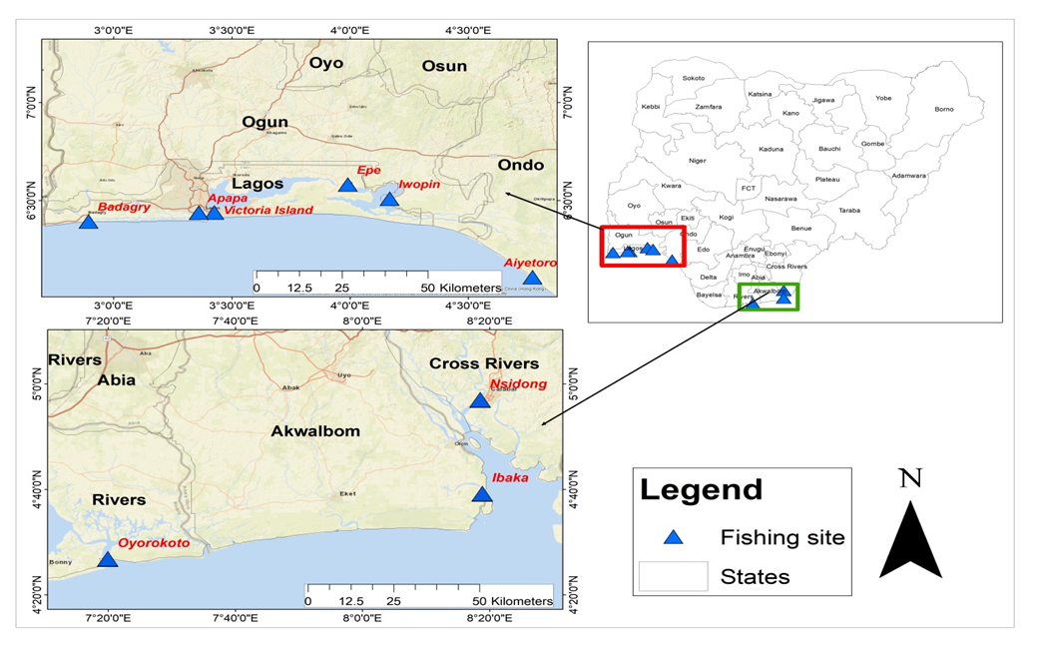
STUDY AREA
The study was carried out in the wet season (May-June, 2025) in six different states in Nigeria namely:
Lagos, Ogun, Ondo, Akwa-Ibom and Rivers states. Nine key coastal locations in each states are considered, these locations are: Epe, Epe local government area, Lagos Island, Lagos state, Badagry local government, Victoria Island, Lagos Island local government, Apapa, Apapa local government. Aiyetoro, Ilaje local government area, Ondo state, Iwopin, Ogun waterside local government area, Ogun state, Nsidung Calabar South local government area, Calabar, Cross river state, Ibaka, Mbo local government area, Uyo, Akwa-Ibom state and Oyokoroto, Andoni local government area, Portharcourt , Rivers state.
Map showing the Costal areas in the six states in Nigeria
Personal comunication
4
Presented by: Damilola Arokoyu

Slide 6
METHODOLOGY
Pre-study to identify suitable coastal communities was conducted.
An average of seven species of fishes and macroinvertebrates were procured, photodocumented, measured and weighed.
At the laboratory, fishes and macroinvertebrates were gutted to remove their GIT content and part of their tissues (muscle).
The retrieved GIT and tissues (muscle) were weighed, dissolved Potassium Hydroxide (KOH) and H2SO4 and filtered.
The filters were examined under a microscope and microplastics were counted, measured and photographed at 4000X magnification.
Ethical approval was obtained for this study
Assessment of Microplastics in Commercial Fisheries procured from six Coastal states in Nigeria
5
Presented by: Damilola Arokoyu

Slide 7
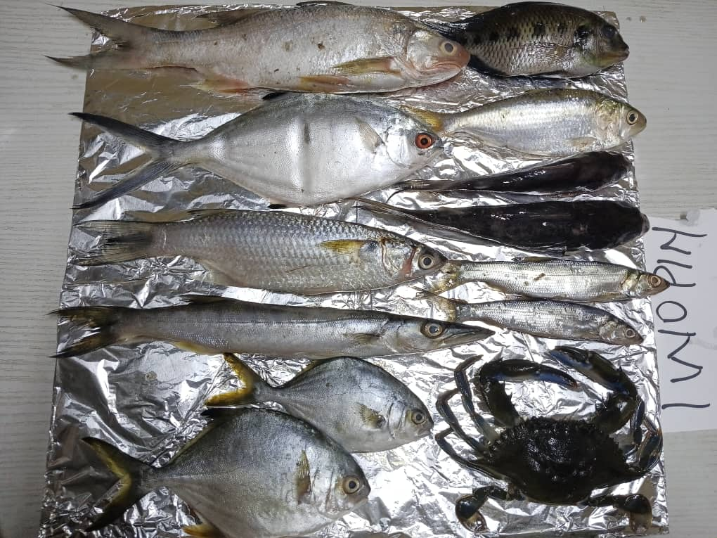
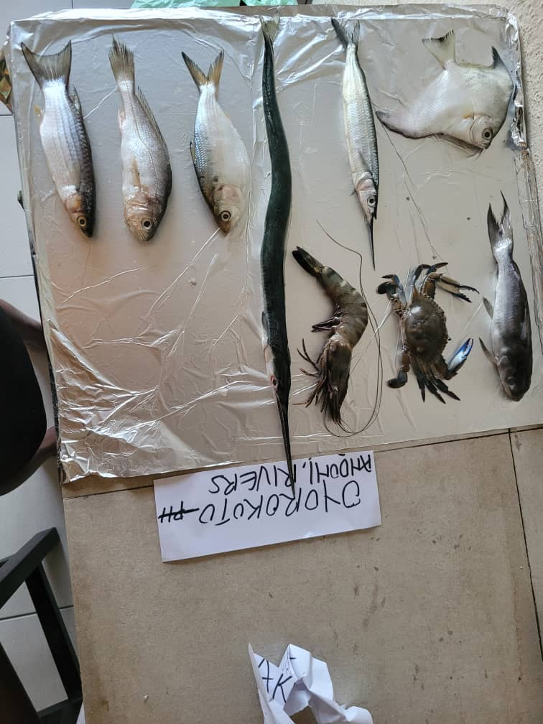
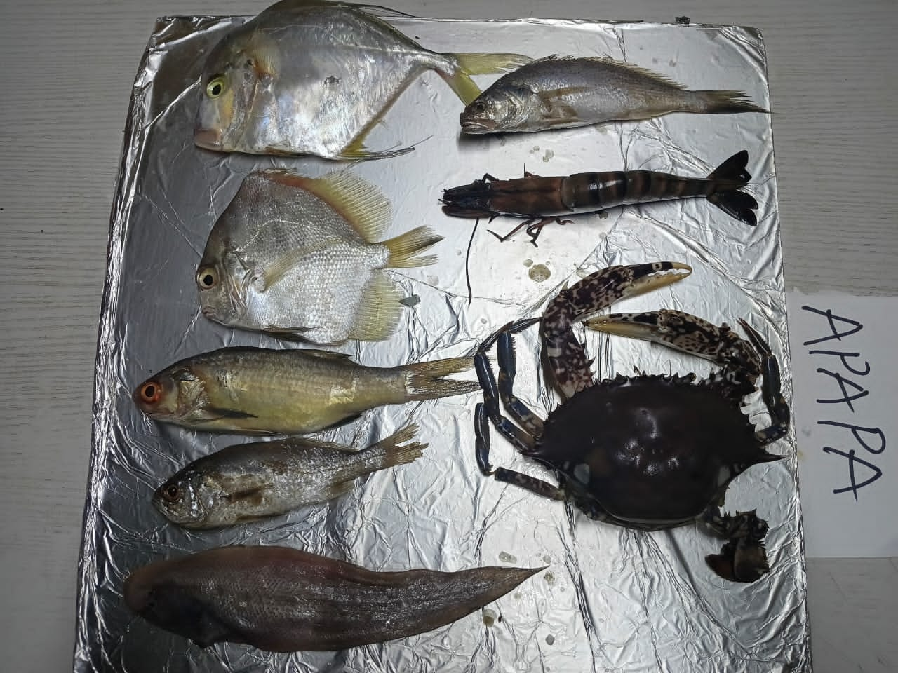
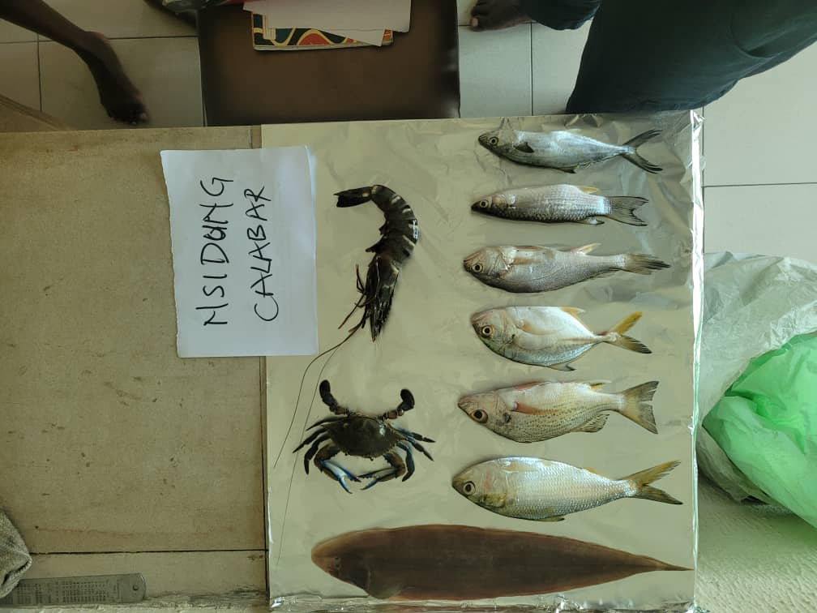
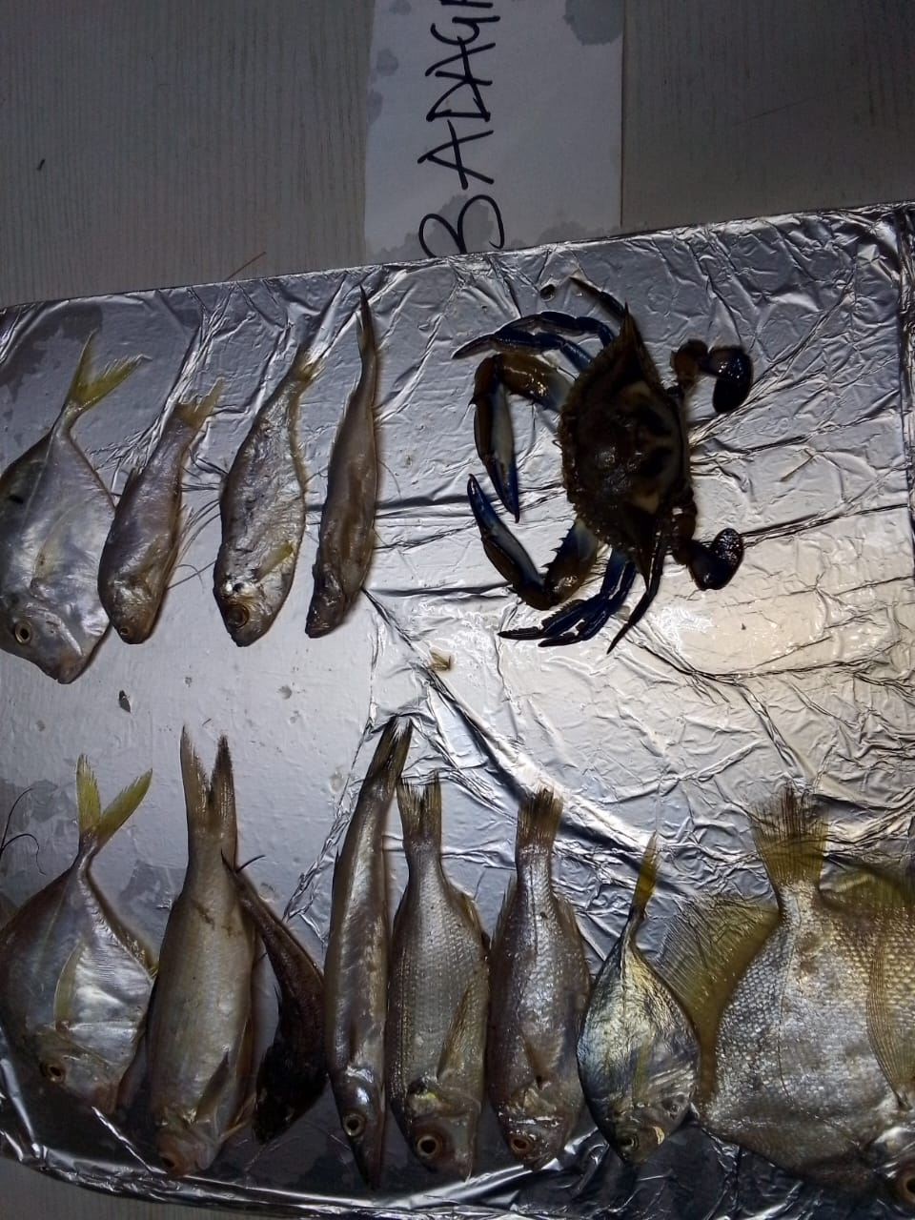
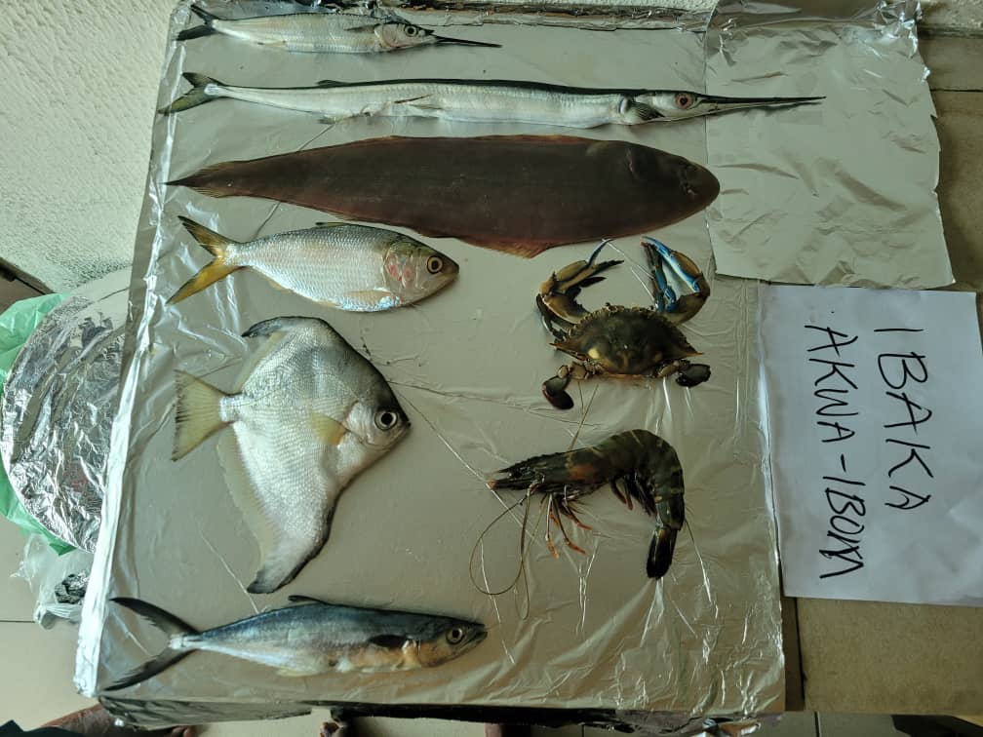
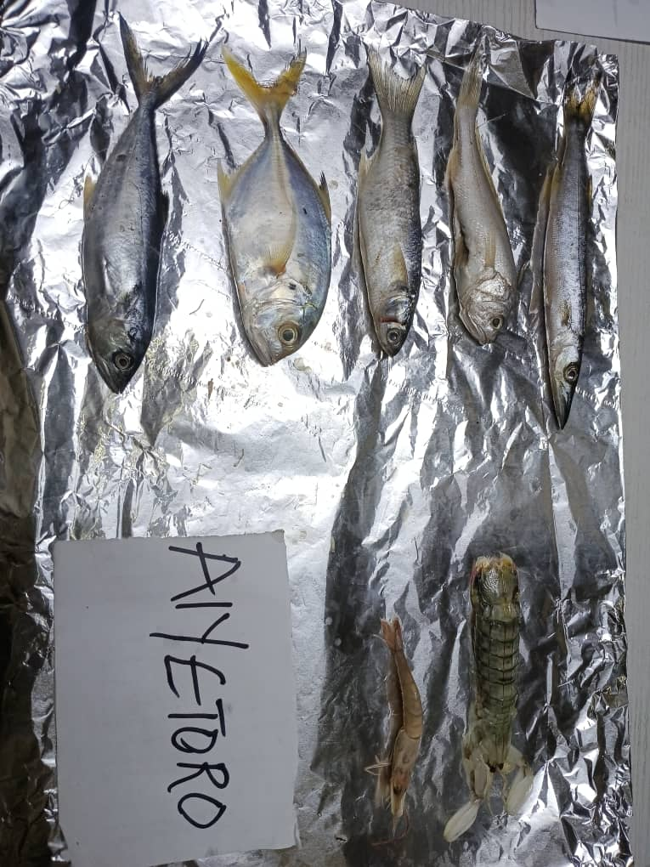
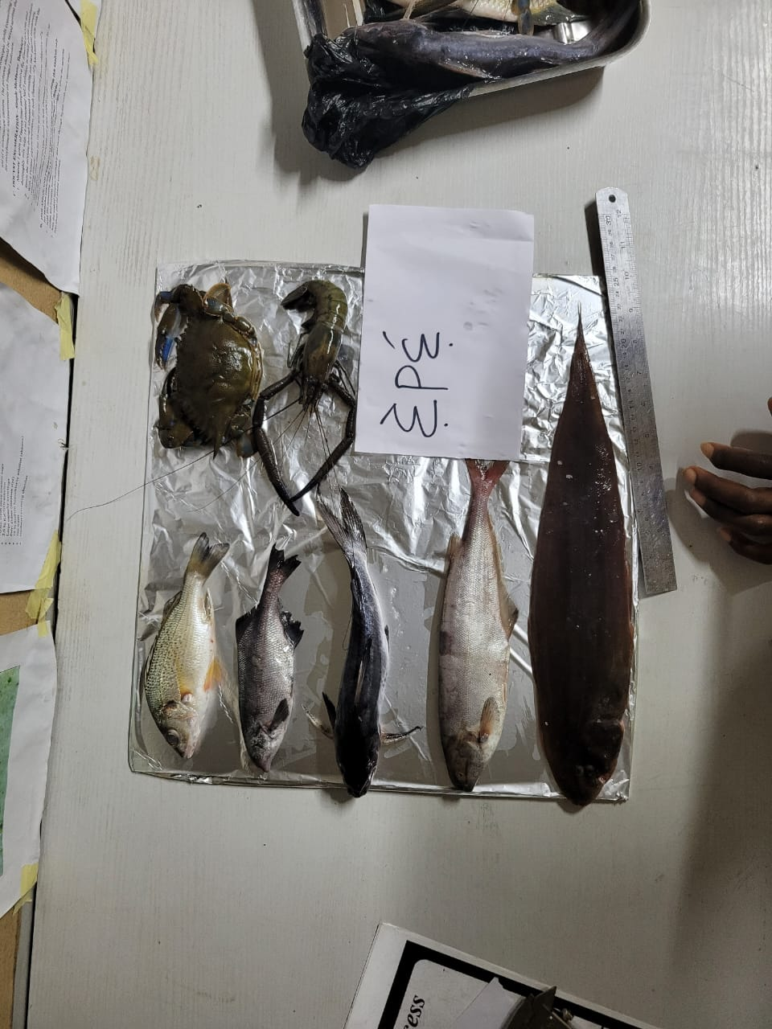
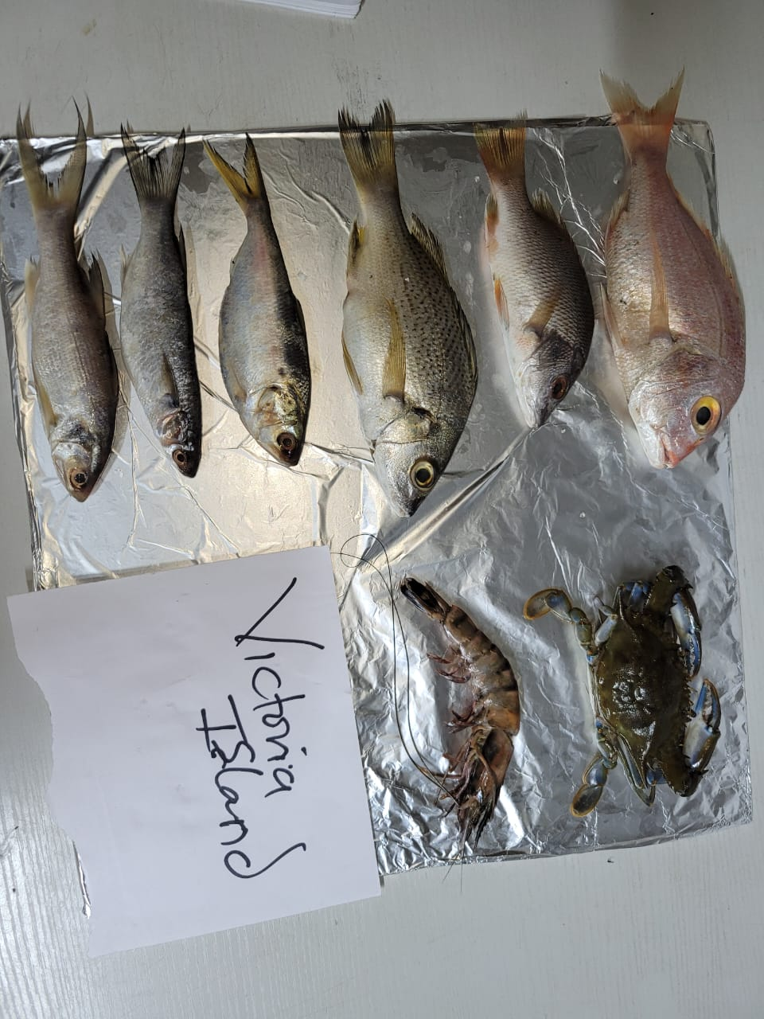
DIFFERENT SPECIES OF FISHES PROCURED FROM THE NINE LOCATIONS OF THE SIX COASTAL STATES IN NIGERIA
Plate 1 : Fish and macroinvertebrates from Iwopin
Plate 2 : Fish and macroinvertebrates from Oyokoroto
Plate 3: Fish and macroinvertebrates from Apapa
Plate 4: Fish and macroinvertebrates from Nsidung
Plate 5: Fish and macroinvertebrates from Badagry
Plate 6: Fish and macroinvertebrates from Ibaka
Plate 7:Fish and macroinvertebrates from Aiyetoro
Plate 8: Fish and macroinvertebrates from Epe
Plate 9: Fish and macroinvertebrates from Victoria Island

Slide 8
RESULT
MORPHOMETRICS AND CONDITION FACTOR
A total of 38 sample species were procured with fish composing of 32 species of fish and 6 species of macroinvertebrates.
Fulton’s condition factor was calculated using:
K_{F}= 100 (W/L₃)
Where:
W = weight of the body (g)
L = total length (cm)
The minimum and maximum Fulton’s conditional factor calculated across sampled fish species from all study area is 0.11 to 3.03 respectively for fishes while that of macroinvertebrates are 0.21 to 47.49. The estimated average value is 0.97 for fishes and 9.66 for macroinvertebrates.
Fulton’s condition factor revealed that a greater number of fishes live in environment with fair conditions, while some macroinvertebrates live in better condition.
Assessment of Microplastics in Commercial Fisheries procured from six Coastal states in Nigeria
Presented by: Damilola Arokoyu
7

Slide 9
MORPHOMETRICS OF FISH AND MACROINVERTEBRATES SPECIES PROCURED FROM NINE MAJOR LANDING SITES ACROSS SIX COASTAL STATES IN NIGERIA
STATE | SAMPLING LOCATIONS | ENGLISH NAME | SCIENTIFIC NAME | WEIGHT (g) | TOTAL LENGTH (cm)
FISH
LAGOS | Epe | White-bellied snapper | Lutjanus rivulatus | 76 | 18
 |  | Mormyrid fish | Marcusenius mento | 58 | 17.8
 |  | Silver Cat Fish | Chrysichthys nigrodigitatus | 135 | 26
 |  | Bebe mormyrid | Hyperopisus bebe | 135 | 27
 |  | Sole fish | Solea solea | 185 | 40
 | Apapa | Diamond Trevally | Alectic Indica | 160 | 21.9
 |  | Silver Pomfret | Pampus Argenteus | 86 | 14
 |  | Shiny Nose | Polydactylus quadrifilis | 90 | 21.5
 |  | Silver white croaker | Genyonemus lineatus | 44 | 15
 |  | Sole fish | Solea solea | 55 | 23
 |  | Booseman Croaker | Boesemania microlepsis | 64 | 20.3
 | Victoria Island | Red Seabream | Pagrus major | 179 | 22
 |  | Red Snapper | Lutjanus campechanus | 84 | 17
 |  | White-bellied snapper | Lutjanus rivulatus | 160 | 22
 |  | Sardine fish | Sardina pilchardus | 55 | 17.5
 |  | Blue Spot mullet | Mugil cephalus | 52 | 17.5
 |  | Shiny Nose | Polydactylus quadrifilis | 60 | 20
 | Badagry | Diamomd Trevally/Indian threadfin | Alectic Indica | 59 | 15.7
 |  | Shiny Nose | Polydactylus quadrifilis | 81 | 19.5
 |  | Bartail Flathead | Platycephalus indicus | 16 | 14
 |  | Obtuse Baracuda | Sphyraena obtusata | 36 | 19.8
 |  | Bogue | Boops boops | 52 | 16
 |  | Yellow croacker | Larimichthyts polyactis | 39 | 14.5
 |  | American butterfish | Peprilus triacanthus | 14 | 13
 |  | Silver Pomfret | Pampus Argenteus | 88 | 15.2
 |  | Bumpnose Trevally | Carangaides hedlandensis | 50 | 16.4
 |  | Atlantic herring | Clupea harengus | 19 | 12.5
 |  | Bonga | Ethmalosa fimbriata | 19 | 13.5
 |  | Longneck croaker | Pseudotolithus Typhus | 22 | 15.7
ONDO | Aiyetoro | Obtuse Baracuda | Sphyraena obtusata | 30 | 19.2
 |  | Silver white croaker | Genyonemus lineatus | 27 | 15.6
 |  | Blue Spot mullet | Mugil cephalus | 27 | 15.4
 |  | Giant trevally | Caranx ignobilis | 42 | 14.6
 |  | Mackerel | Scomberomorus cavalla. | 30 | 16.7

Slide 10
MORPHOMETRICS OF FISH AND MACROINVERTEBRATES SPECIES PROCURED FROM NINE MAJOR LANDING SITES ACROSS SIX COASTAL STATES IN NIGERIA
STATE | SAMPLING LOCATION | ENGLISH NAME | SCIENTIFIC NAME | WEIGHT (g) | TOTAL LENGTH (cm)
OGUN | Iwopin | Four finger thread fin | Eleutheronema tetradactylum | 228 | 30.1
 |  | The pompano/Silver fish | Trachinotus ovatus | 135 | 25.8
 |  | Blue Spot mullet | Mugil cephalus | 123 | 24.6
 |  | Obtuse Baracuda | Sphyraena obtusata | 106 | 28.8
 |  | Silver Pomfret | Pampus Argenteus | 90 | 17.7
 |  | Planet catfish | Chrysicthys brachynema | 89 | 21.6
CROSS RIVERS | Nsidung | Sole fish | Solea solea | 81 | 38.5
 |  | Bonga | Ethmalosa fimbriata | 116 | 23.3
 |  | White snapper | Pristipomoides typhus | 110 | 20.2
 |  | Yellow tail | Seriola dorsalis | 82 | 18
 |  | Croaker | Genyonemus lineatus | 64 | 20.1
 |  | Mullet | Mugil cephalus | 55 | 17.5
 |  | Blue runner | Caranx crysos | 39 | 18.5
AKWA-IBOM | Ibaka | Half beak/Japanese fish | Hyporhamphus sajori | 49 | 25.7
 |  | Gar fish | Belone belone | 142 | 49.8
 |  | Sole fish | Solea solea | 240 | 41.7
 |  | Bonga | Ethmalosa fimbriata | 106 | 21.8
 |  | African moony | Mene maculata | 131 | 17.2
 |  | Blue runner | Caranx crysos | 75 | 23.6
RIVERS | Oyokoroto | African moony | Mene maculata | 62 | 12.7
 |  | Half beak/Japanese | Hyporhamphus sajori | 52 | 26
 |  | Garfish | Belone belone | 123 | 48.1
 |  | Bonga | Ethmalosa fimbriata | 78 | 17.8
 |  | Silver white croaker | Genyonemus lineatus | 62 | 20.3
 |  | Mullet | Mugil cephalus | 66 | 19.1
 |  | Silver cat fish | Chrysichthys nigrodigitatus | 81 | 22.3
MACROINVERTEBRATES
LAGOS | Epe | Prawn | Macrobrachium Macrobrachion | 58 | 30.47
 |  | Atlantic Blue Crab | Callinectes Sapidus | 148 | 6.78
 | Apapa | Tiger prawn | Penaeus monodon | 49 | 19.5
 |  | Smooth swim crab | Penaeus monodon | 252 | 8.8
 | VI | Tiger prawn |  | 27 | 14.5
 |  | Atlantic Blue Crab | Callinectes Sapidus | 91 | 6.1
 | Badagry | Atlantic blue crab | Callinectes Sapidus | 75 | 11.4
ONDO | Aiyetoro | Mantis shrimp | Lysiosquillina maculata | 16 | 11.6
 |  | Red cray fish | Procambarus clarkii | 5 | 10
OGUN | Iwopin | Atlantic Blue Crab | Callinectes Sapidus | 73 | 11.1
CROSS RIVERS | Nsidung | Atlantic Blue Crab | Callinectes Sapidus | 51 | 19.5
 |  | Tiger prawn | Penaeus monodon | 55 | 20.5
AKWA-IBOM | Ibaka | Atlantic blue crab | Callinectes Sapidus | 81 | 10.5
 |  | Tiger prawn | Penaeus monodon | 55 | 18
RIVERS | Oyokoroto | Atlantic blue crab | Callinectes Sapidus | 51 | 9.3
 |  | Tiger prawn | Penaeus monodon | 50 | 18.5

Slide 11
CHARTS SHOWING THE FULTON’S CONDITION FACTOR OF FISHES AND MACROINVERTEBRATES PROCURED
FROM NINE LOACATIONS ACROSS THE SIX COASTAL STATES IN NIGERIA
Fig 1: Condition factors of Fish procured from the nine locations
Fig 2: Condition factors of Macroinvertebrates procured from the nine locations

Slide 12
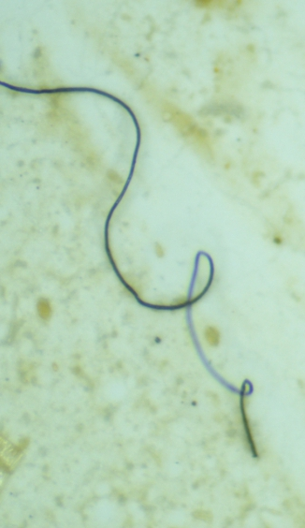
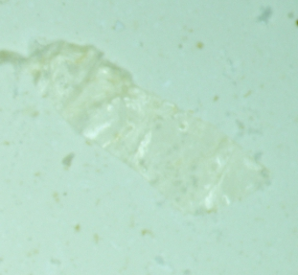
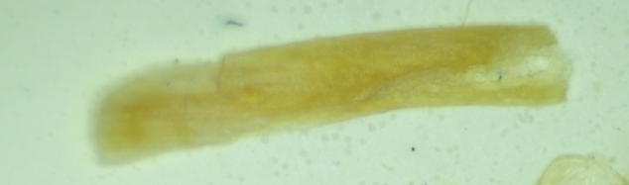
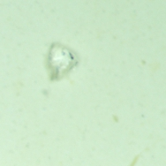
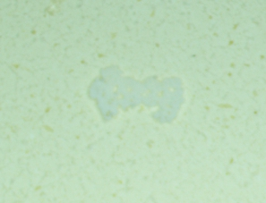
RESULT
MICROPLASTICS COUNT
Microplastics was detected in all tissues (muscle) of fishes and macroinvertebrates but was not found in the GIT and tissue of the same fish sample (Blue Spot mullet) procured from two different locations (GIT-Aiyetoro and Muscle-Iwopin.)
Microplastics sizes ranged from
  0.01-1.53mm in the GIT of Fish
  0.01-1.38mm in the tissues (muscle) of fishes
  0.02-2.23mm in the GIT of Macroinvertebrates
  0.01-1.91mm in the tissues (muscle) of Macroinvertebrates
Microplastics identified in various colours: Brown, Black, Yellow, Blue, White, Red and Green and also in various forms such as Fiber, Film, Fragment, Pellet and Foam
Different Forms of Microplastics
Assessment of Microplastics in Commercial Fisheries procured from six Coastal states in Nigeria
11
Presented by: Damilola Arokoyu

Slide 13
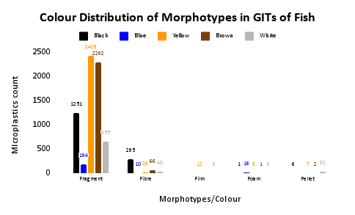
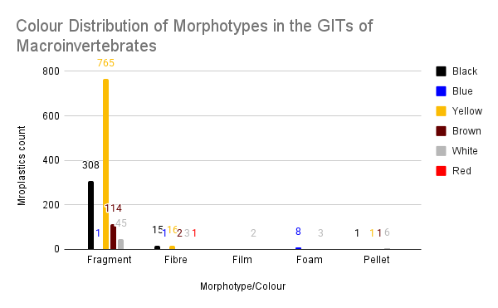
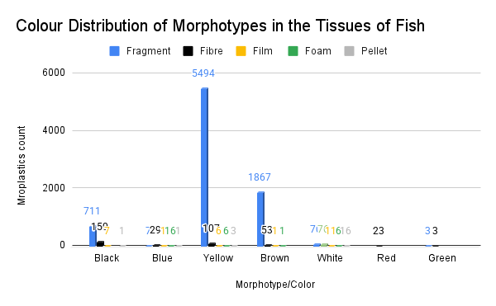
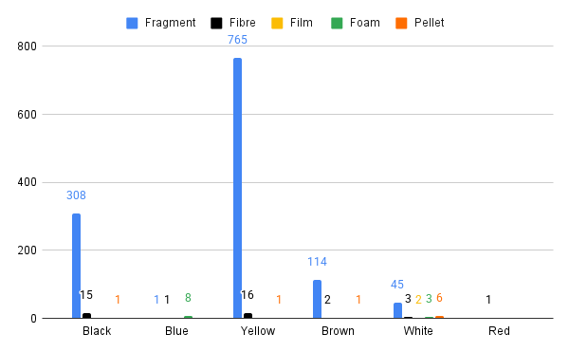
COLOUR DISTRIBUTION OF MORPHOTYPES OF GITS AND tissues (muscle) OF FISH SAMPLES FROM THE NINE LOACATIONS ACROSS SIX COASTAL STATES IN NIGERIA
Fig 1: Colour Distribution of Morphotypes of GIT of Fish samples
Fig 2: Colour Distribution of Morphotypes of GIT of Macroinvertebrate samples
Fig 3: Colour Distribution of Morphotypes of tissues (muscle) of Fish samples
Fig 4: Colour Distribution of Morphotypes of tissues (muscle) of Macroinvertebrate samples

Slide 14
CONCLUSION AND RECOMMENDATIONS
Conclusion
Increased plastic production and use has led to higher microplastic occurrence.
Microplastics contribute to an unhealthy aquatic environment.
Their presence in most fish and macroinvertebrate samples highlights risks to fisheries and human health.
Recommendations
Enforce strict policies to reduce plastic disposal in water bodies.
Provide incentives for plastic collection and proper disposal.
Develop effective methods for plastic cleanup in marine bodies.
Raise public awareness on impact of microplastics on health and the environmental.
Involve stakeholders in the process of mitigatingg plastic pollution
Promote alternatives to plastics (encourage the use of biodegradable materials for example).
Encourage research on recycling and reuse strategies of plastics.
Encourage more researches that focuses more on the presence of microplastics in the tissues (muscle), especially in edible tissues (muscle) of fishes and macroinvertebrates.
Conduct further studies on microplastics’ impact on commercial fisheries across regions and seasons in Nigeria.
Assessment of Microplastics in Commercial Fisheries procured from six Coastal states in Nigeria
13
Presented by: Damilola Arokoyu

Slide 15
REFERENCES
Gideon Aina Idowu, Adewunmi Yetunde Orji, Kehinde Oluwasiji Olorunfemi, Micheal Ouwatoyin Sunday, Temitoipe Olawunmi Sogbanmu, Oluwatoyin Kikilomo Bodunwa, Oluwatosin Sarah Shokunbi, Ademola Festus Aiyesanmi. (2024). Why Nigeria should ban single-use plastices: Excessive microplastic pollution of the water, sediments and fish species in Osun River, Nigeria. Journal of Hazardous Material Advances. Vol 13.
Marn, N., Jusup, M., Kooijman, S., Klanjscek. T (2020). Quantifying impacts of plastic debris on marine wildlife identifies ecological breakpoints. Ecol. Lett., 23 : 1479-1487.
Oluwatosin Modupe Olarinmoye, Friedika Stock, Nadine Scherf, Olusegun Whenu, Charles Asenime, Sylvester Ganzallo. (2020). Microplastic presence in sediment and water of a Lagoon Bordering the urban agglomeration of Lagos, Southwest, Nigeria. Geosciences. 10: 494.
Emeka Dumbill and Lesley Henderson (2020). The challenge of plastic pollution in Nigeria. Environmental Impact, Societal Issues, Prevention and Solution. 22:569-583.
Nweke, N.D., Agbasi, J.C., Aiyejoto, D.A., Onuba, L.N., Egbueri, J.C. (20140. Sources and environmental distribution of microplastics in Nigeria. In: Egbueri, J.C., Ighala, J.O, Pande, C.B. (eds). Microplastics in African and Asian Environments.: Emerging Contaminants and Assiociated Treatment Technologies.. Pp 107-130.
Assessment of Microplastics in Commercial Fisheries procured from six Coastal states in Nigeria
14
Presented by: Damilola Arokoyu

Slide 16
ACKNOWLEDGEMENT
Research partners, Dr Sogbanmu Temitope (Supervisor), Mr Sola Ogunfeitimi, Mz Esther Akilo
and coastal community representatives
Funders- Social Sciences and Humanities Research Council (SSHRC) of Canada within the Solving Sustainability Challenges at the Food-Climate-Biodiversity Nexus (Solving FCB) West Africa Case Study (UNILAG Team) led by Dr Sogbanmu Temitope .
University of Lagos Research Ethics Committee
Assessment of Microplastics in Commercial Fisheries procured from six Coastal states in Nigeria
15
Presented by: Damilola Arokoyu

Slide 17
THANK YOU
Presented by:
Damilola Arokoyu
Assessment of Microplastics in Commercial Fisheries procured from six Coastal states in Nigeria
15

